Slide 1


“Dietary Recipe Finder“
Dept. of CS&E ( DATA SCIENCE)
Adichunchanagiri Institute of Technology
Chikkamagaluru - 577102
Presented By,
Name : Bhavana N (4AI22CD007)
Name : Eksha D V (4AI22CD019)
Name : Sunaina A G (4AI22CD055)
Name : Manmitha N K (4AI22CD033)
Under the Guidance of
Prof. Harshitha H D

Slide 2
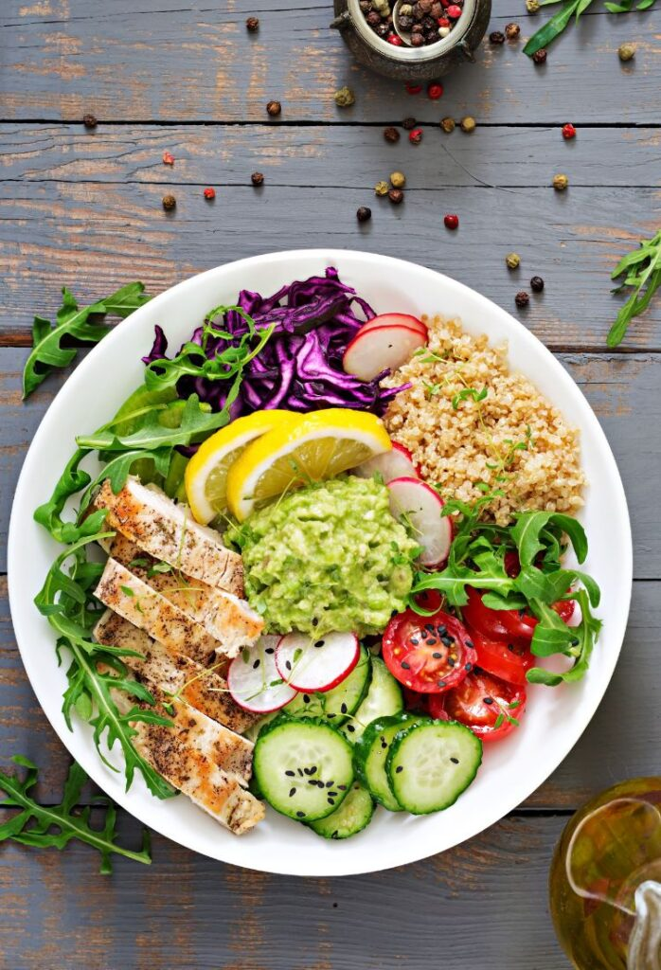
Dietary Recipe Finder

Slide 3
Problem Statement
To design and implement the dietary recipe finder to simplify meal planning for users with specific dietary needs, promoting healthier eating habits through personalized and accessible recipe options.

Slide 4
Scope of the project
Key areas the project focuses on:
User-Friendly Interface: Ensuring the application is easy to use and visually appealing.
Search Functionality: Allowing users to find recipes based on ingredients, dietary restrictions like vegetarian and non-vegetarian.
Recipe Database: Maintaining a collection of recipes with details like ingredients and cooking instructions.
Personalization: Offering tailored recipe recommendations based on user preferences and dietary goals.

Slide 5
Expected Impact or Benefits:
Health Improvement: By providing access to nutritious and balanced recipes, users can make healthier food choices that align with their dietary goals and restrictions.
Time Savings: With easy access to a variety of recipes, users can quickly find meal ideas without spending hours searching the internet or cookbooks.
Customization: Users can tailor their meal plans to their specific dietary needs, whether they are vegetarian, non- vegetarian or have other dietary restrictions.
Convenience: Having a centralized platform for recipe discovery and meal planning can simplify the cooking process and make it more enjoyable.

Slide 6
Project Design
Components involved:
Software: HTML, CSS , JavaScript, Visual studio,
Recipe Engine: Logic to filter and recommend recipes based on user input.
User Management: Handles user accounts, preferences, and dietary restrictions.

Slide 7
Methodology

Slide 8
Implementation
Highlights of the Code:
Image Handling: Uses JPG format for recipe images to ensure good quality.
Web Interface: Built with HTML and CSS for a simple and easy-to-use design.
Data Management: Uses JSON to organize and share recipe information easily.
Screenshots or Snippets:
Output Display Example: Show an example of the output format, displaying the extracted recipe name, ingredients, and preparation steps based on the processed image.

Slide 9
Results
Output or Outcomes Achieved:
Accurate identification of dietary recipes based on ingredients.
Display of information including recipe name, ingredients, and cooking steps.
Screenshots:
Accuracy Comparison: Show a chart comparing predicted recipe names with actual recipe names based on ingredient searches.
Output Interface: Provide screenshots of the user interface displaying the identified recipes, including their names, ingredients, and preparation steps.

Slide 10
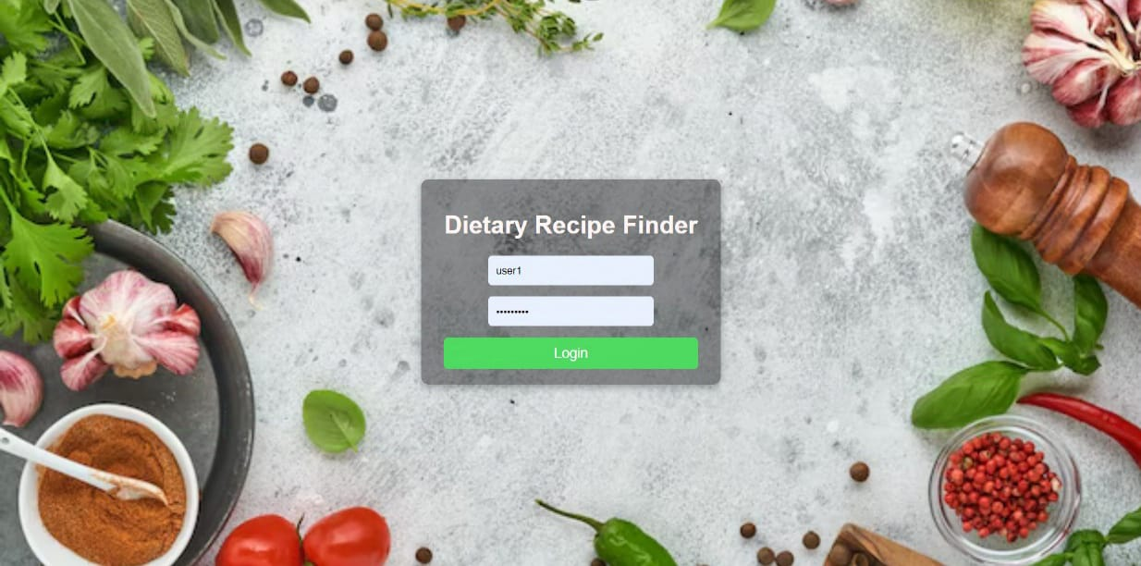
login page allows users to enter their username and password to access their accounts.

Slide 11
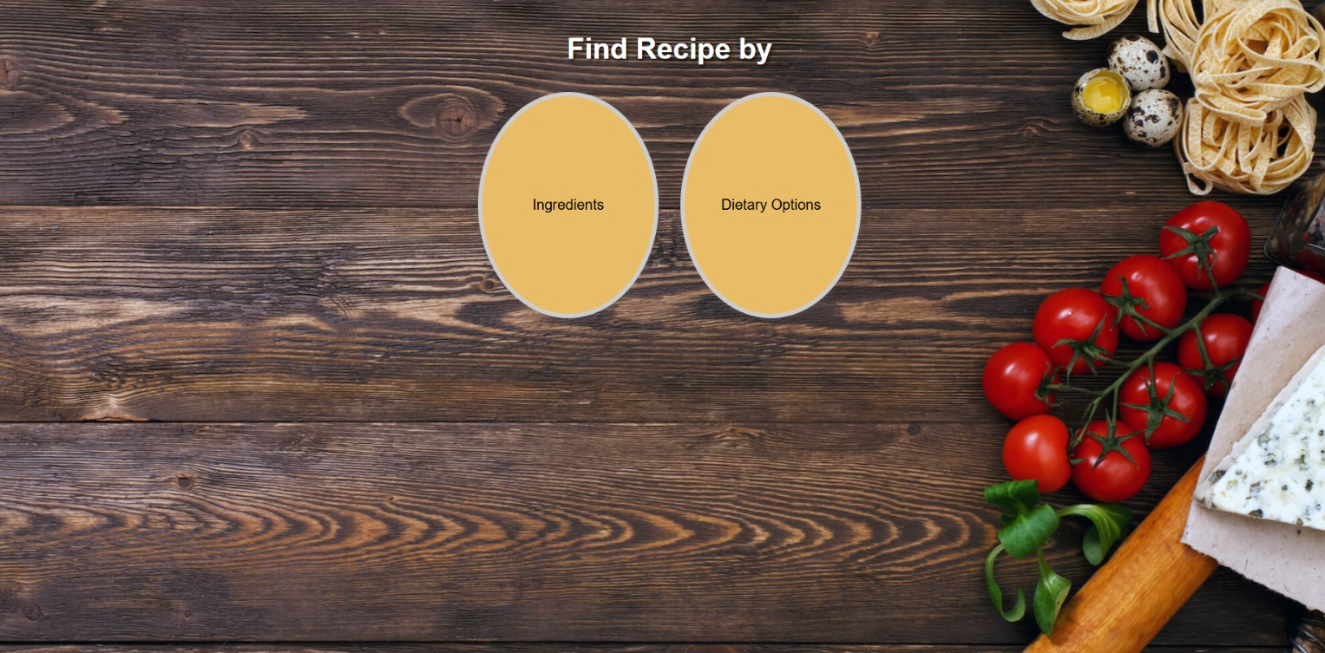
Here we can find recipe by : ingredients or Dietary-options.

Slide 12
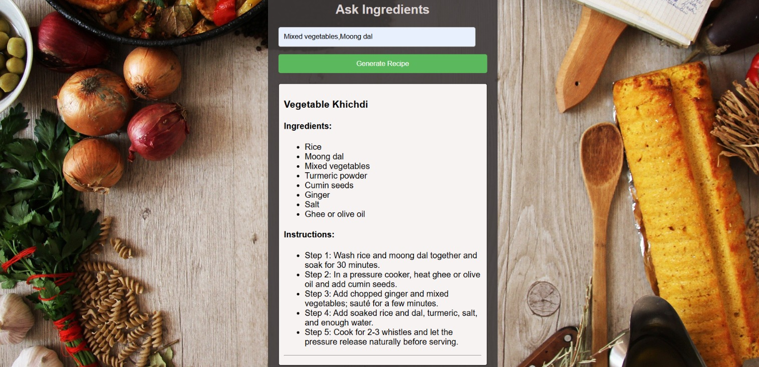
For example, clicking on the ingredients will display the corresponding recipe.

Slide 13
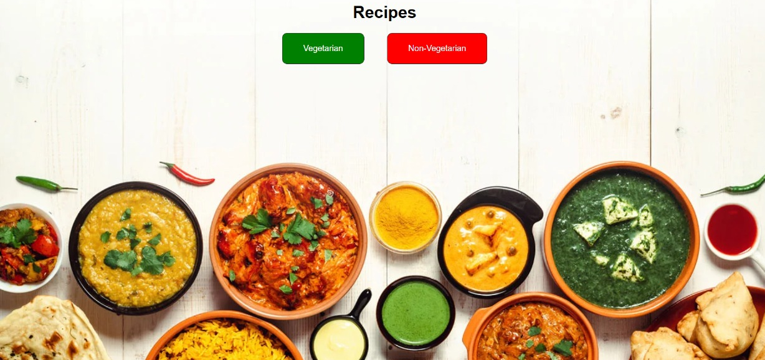
After selecting 'Dietary Options', you'll reach the Veg or Non-Veg page. Choose 'Vegetarian' or 'Non-Vegetarian' to receive tailored recipe suggestions.

Slide 14
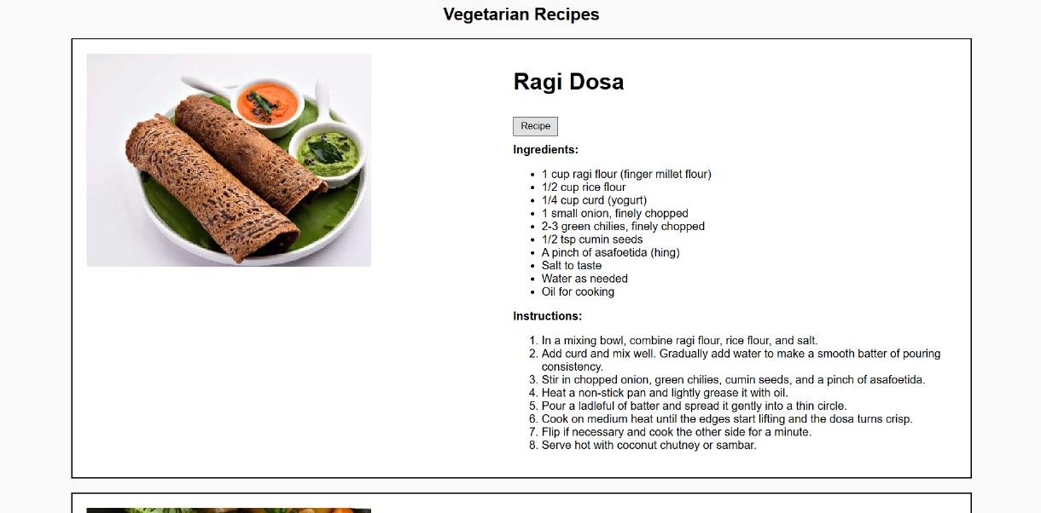
After selecting the vegetarian we’ll get the vegetarian dietary recipe including detailed ingredients and instructions.

Slide 15
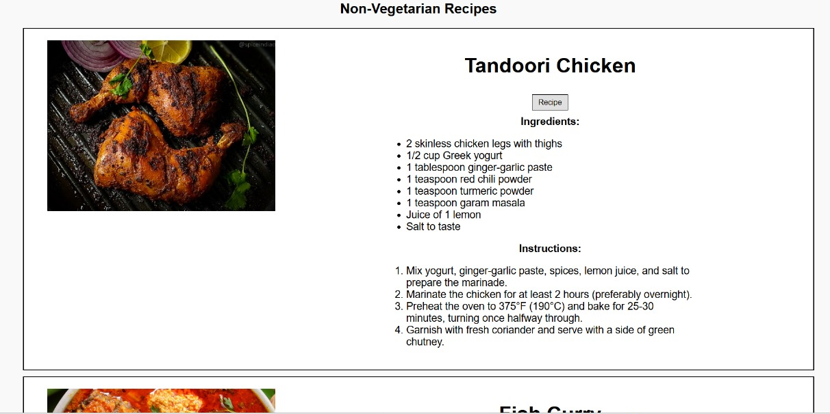
After selecting the Non-vegetarian we’ll get the Non-vegetarian dietary recipe including detailed ingredients and instructions.

Slide 16
Challenges Faced
Issued Encountered:
App functionality and technical errors.
Finding specific foods or ingredients.
Understanding the nutritional details.
How they were resolved:
Clear, update and reinstall.
Using broad search terms or more generic names.
Cross-reference with trusted sources.

Slide 17
Future Work
Enhance the recipe dataset by adding more dietary recipes and cuisines.
Improve feature extraction methods for better accuracy in ingredient matching.
Implement dietary needs detection for personalized recipe suggestions.

Slide 18
Conclusion
This project successfully created a useful recipe finder that helps people find recipes based on what they like to eat and any dietary restrictions they have. It encourages healthy eating and helps users discover nutritious ingredients while promoting the importance of balanced diets.

Slide 19
GitHub Link
EKSHA D V: https://github.com/EKSHADV17/mini-project
SUNAINA A G: https://github.com/SUNAINA03AG/miniproject
BHAVANA N: https://github.com/bhavananagesh/miniproject
MANMITHA N K: https://github.com/MANMITHA05NK/miniproject

Slide 20
THANK YOU

